Slide 1
PI UK „What Happened to PROFIBUS?“ AFRC, Glasgow
PROFINET over TSN

Slide 2
Time Sensitive Networking (TSN)
Why do we need it?
Digitalization
Exponential rise in ethernet capable devices and their generation/consumption of data
Paradigm shift
Network ‘convergence’ - IT and OT devices in one network sharing Quality of Service (QoS)
Notes:
Thanks to the advisory committee that created the program and moderates the sessions. But someone is always needed who brings all the threads together and organizes everything. Frithjof as leader of the program committee (director of the Institute for Automation & Industrial IT, TH Köln University of Applied Sciences).
Questions:
Isn’t everything a little different this year, or not? -> to the community meeting place/ workshop / response to the issue of future viability.
How did we get from the word cloud to the program that we hold in our hands? Focal points: Communication technology / Semantics and information models / Security / New business models-> Event format
Thank sponsors: 16 sponsors
App: Evaluation of presentations – we evaluate ourselves. Feedback forms
Segue:
This new orientation is also the basis of the first presentation: Big Picture
But before we look into the future, we’ll begin first with where we are today. And who could be better to do that with Frithjof than Xaver Schmidt?

Slide 3
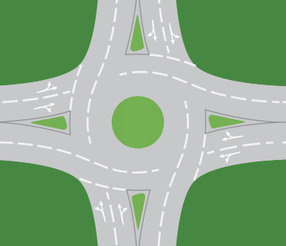
Why Standard Ethernet is not real-time capable? How will TSN help?
Congestion (up to congestion loss) at an egress port creates latency variation for real-time frames
Single frames occupying an egress port creates latency variation for real-time frames
Remedy:
Reduce or avoid latency variation
Pre-calculated frame scheduling from end to end
Increase bandwidth
Dedicated networks for real-time
Reduce occupation of an egress port in case of real-time traffic- ‘preemption’
RT
Egress port
RT
RT
TCP/IP
TCP/IP
RT
A switch is like a roundabout (here: left-hand traffic)

Slide 4
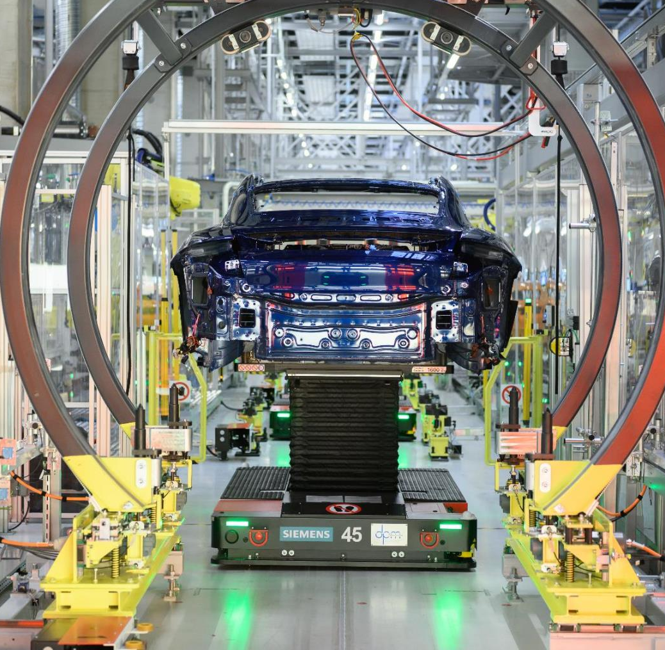
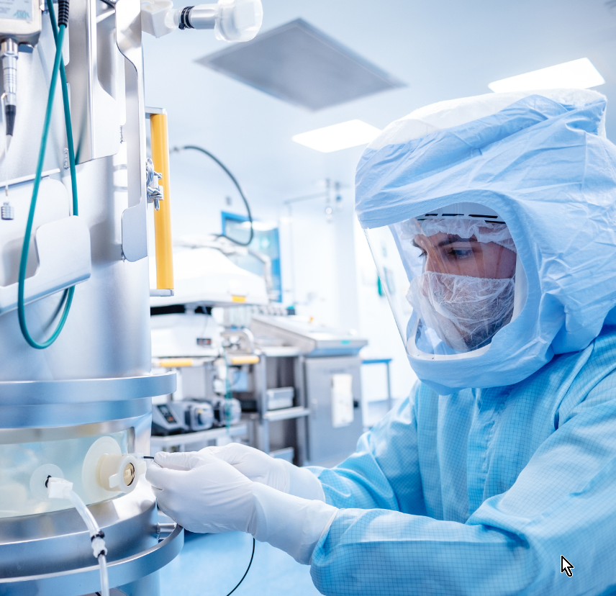
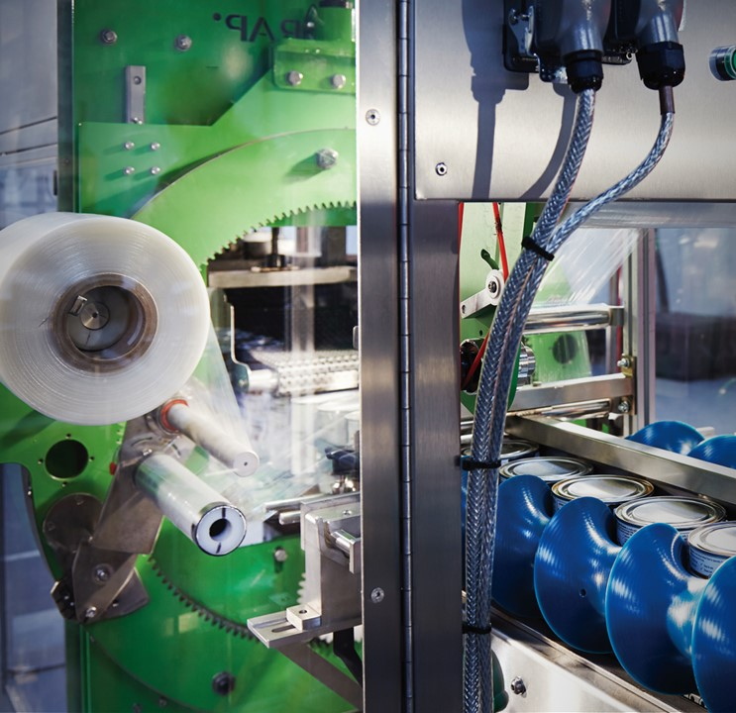
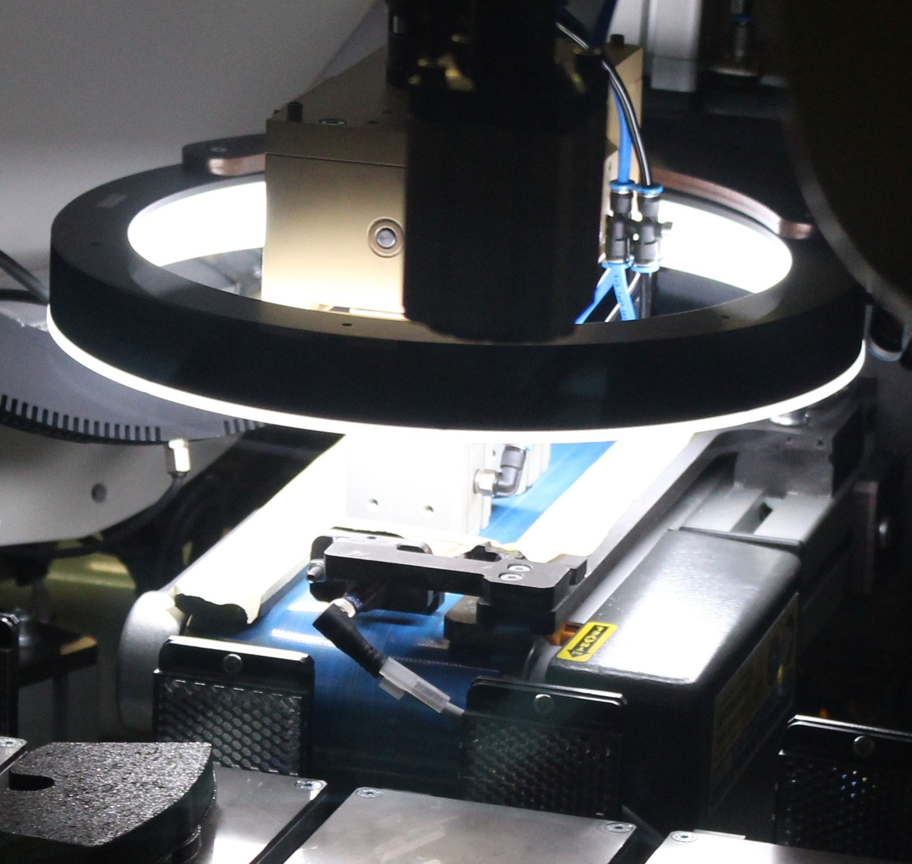
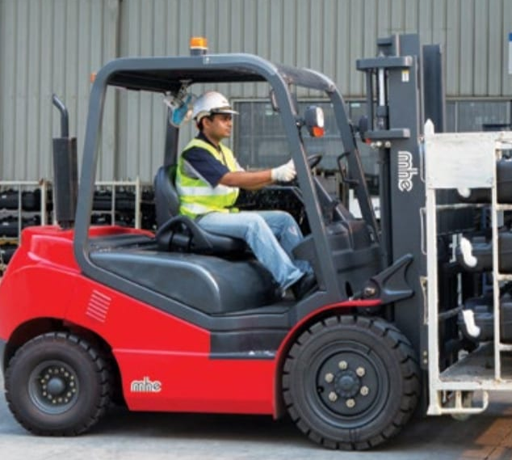
Different industries, different secured converged networks?
Factory Automation
Process Automation
Motion Control
Camera Integration
Worker Environment
One secured converged network needs to cover concurrently the requirements of the different industrial verticals

Slide 5
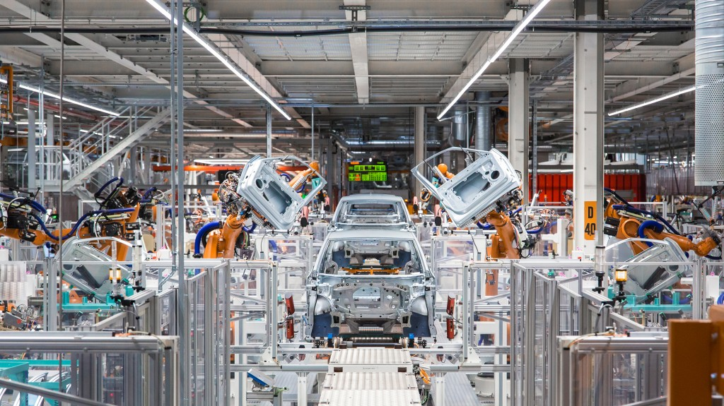
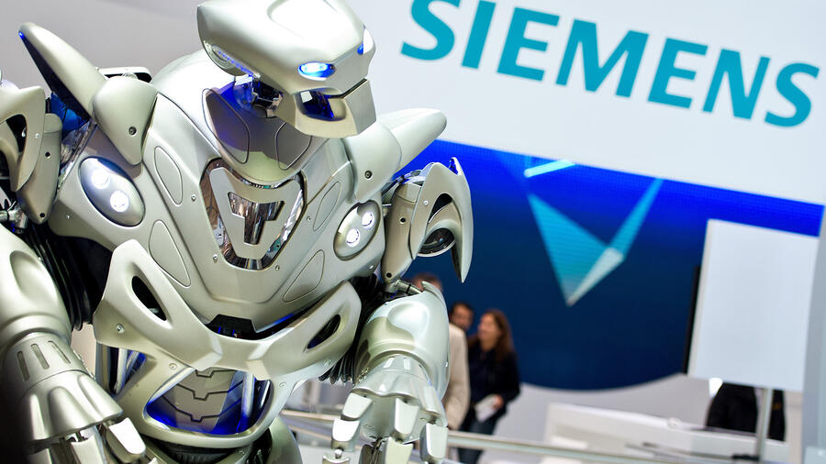
Quantities for secured converged networks
A vehicle manufacturing facility uses more than 50,000 Ethernet nodes
Production cells implement Layer 2 networks with up to 1000 nodes
Automation devices requires up to 2000 streams or time-sensitive streams. Doubling if seamless redundancy is demanded
Multiple wireless connected AGVs or robots are entering and leaving the production cell concurrently
Flexible production requires adding and removing of machines or machine-parts, AGVs, and robots or robot-tools without production disturbance

Slide 6
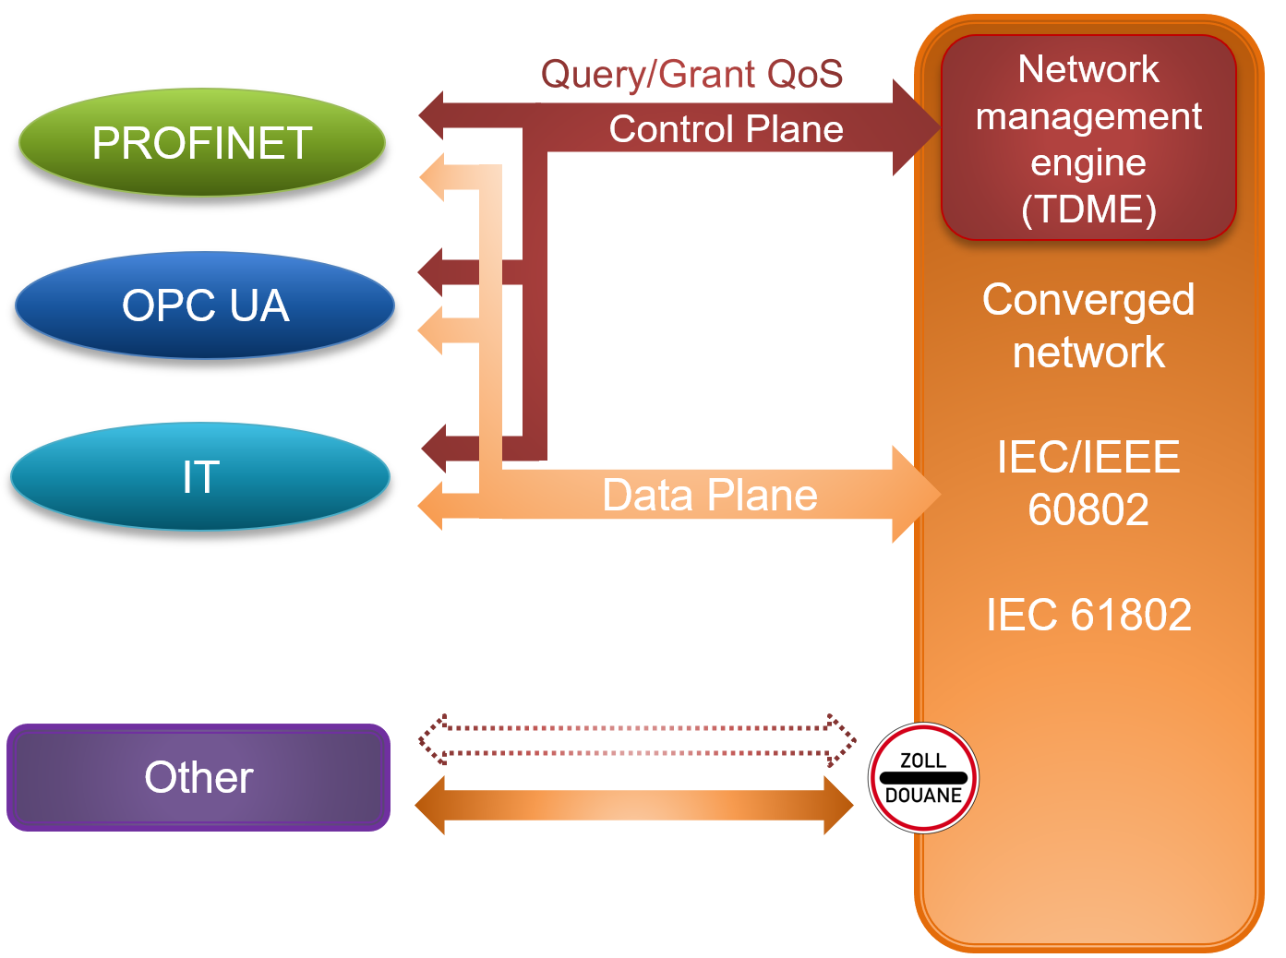
Fundamentals of secured converged networks
IT and OT devices in one network sharing QoS
Applications can be engineered, implemented and deployed independently from the network
Self-protecting network e.g. against wrong connections, unexpected devices or network load
Dynamic adaption: plug and produce (AGV, …), topology changes, extensions for IT and OT devices
Network provides required QoS for the applications
Efficient bandwidth utilization for OT and IT communication
Link speeds from 10 Mbps up to 10 Gbps and Link speed transitions
Flexible topologies: ring, line, tree, star and combinations
Media types: fiber, copper and radio (e.g. wireless and 5G)
Bridges with up to 255 ports
Scalable availability for the network and the devices e.g. by media, network and device redundancy
Reliable and accurate time synchronization for site, plant, line, cell and machine

Slide 7
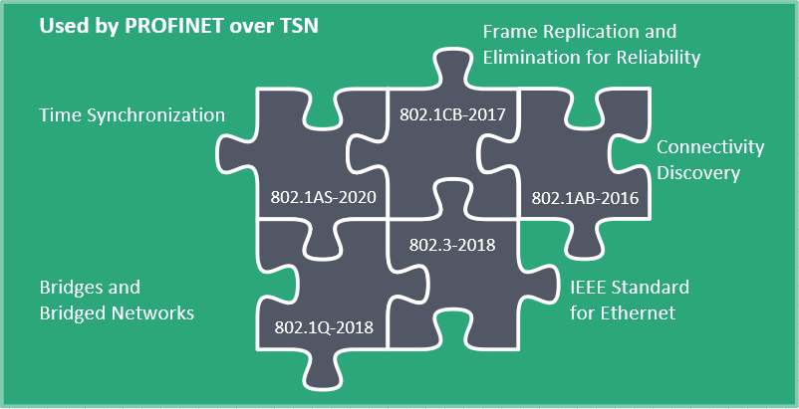
Time Sensitive Networking Mechanisms to guarantee quality of service
TSN is not another Ethernet based fieldbus
TSN is not a replacement for PROFINET, it needs a Fieldbus Application Layer (FAL)
TSN is not a complete protocol suite
TSN is a ‘toolbox’ specified to improve the Quality of Service (QoS) of Ethernet
TSN is designed to enhance network functionality in Layer 2 of Ethernet
TSN is a joint project with IEC/IEEE. Therefore, is a worldwide standard
TSN is an enabler for convergent and reliable networks
TSN is a facilitator for open real time cross-manufacturer communication (e.g. OPC UA over TSN)
What TSN is NOT…
What TSN is…
Notes:
Thanks to the advisory committee that created the program and moderates the sessions. But someone is always needed who brings all the threads together and organizes everything. Frithjof as leader of the program committee (director of the Institute for Automation & Industrial IT, TH Köln University of Applied Sciences).
Questions:
Isn’t everything a little different this year, or not? -> to the community meeting place/ workshop / response to the issue of future viability.
How did we get from the word cloud to the program that we hold in our hands? Focal points: Communication technology / Semantics and information models / Security / New business models-> Event format
Thank sponsors: 16 sponsors
App: Evaluation of presentations – we evaluate ourselves. Feedback forms
Segue:
This new orientation is also the basis of the first presentation: Big Picture
But before we look into the future, we’ll begin first with where we are today. And who could be better to do that with Frithjof than Xaver Schmidt?

Slide 8
PROFINET Stack vs PROFINET Stack with TSN
7: Application
6: Presentation
5: Session
Customer App
PROFINET Customer App
Customer App
PROFINET Customer App
PROFINET Profiles (PROFIdrive, PROFIsafe, etc.)
OPC UA
Companion
PROFINET Profiles (PROFIdrive, PROFIsafe, etc.)
OPC UA
Companion
PROFINET FAL (IO, alarms, records, etc.)
OPC UA
PROFINET FAL
OPC UA
IEEE/IEC 60802
TSN-IA Profile
Layer 1 and 2 will be updated (new HW)
The concepts of IEC/IEEE 60802 will be integrated
No changes from an application point of view
4: Transport layer
TCP / UDP
TCP / UDP
3: Network layer
IP
IP
2: Data link layer
IEEE 802.1
IEEE 802.1
TSN
1: Physical layer
100 Mbps
10 Mbps/ ... /10 Gbps
+ MAU-types
Notes:
Wie weit nach oben geht OPC UA?
… oder OPC UA incl. CS, Application

Slide 9
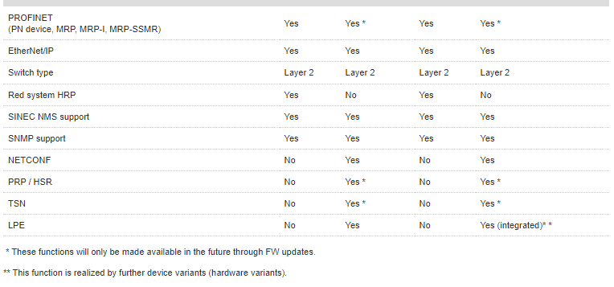
Will I need new hardware?
A "TSN-capable" hardware block is required
Currently Ethernet blocks generally cannot be expanded by software to include TSN functionality
All major block manufacturers have already begun to develop, or have at least announced they will develop hardware blocks with TSN mechanisms…
…therefore, it is anticipated the "standard Ethernet block" will be a TSN-capable Ethernet block in the future
Core requirement was operation in the same network as ‘legacy’ devices
The (…) product line relies on a new operating system on which future functionalities such as PN over TSN and bumpless redundancy procedures can be implemented (Delivery release notes 4.2023)
Yes and no…

Slide 10
PROFINET Conformance Classes (CC)
Application
PN-FAL: Fieldbus Application Layer
Not synchronized
Synchronized
CC-A
RT data exchange,
alarms and diagnostics,
network topology
CC-B = CC-A plus
SNMP support
CC-C = CC-B plus
IRT
CC-D = CC-C plus
TSN
RSI
Remote Service Interface
New transport protocol for
PNIO services
10 / 100 Mbps
100 Mbps
10 Mbps/ … / 10 Gbps

Slide 11
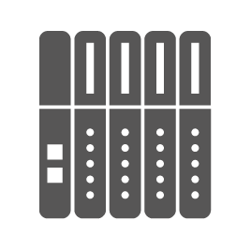
Handling of traffic in the TSN domain
At the domain boundaries:
Controlling the ingress of frames into the TSN domain's network
Special feature of PROFINET devices
PROFINET devices have a defined behavior from which the resource consumption can be derived
Therefore, a relaxed ingress control can be supported for these devices
TSN Domain
Inside the domain:
TSN streams are reserved in the domain
Further ingress data traffic such as OPC UA client/server, HTTP, etc. is also limited in similar manner to the domain boundary
TSN is the robust foundation for PROFINET

Slide 12
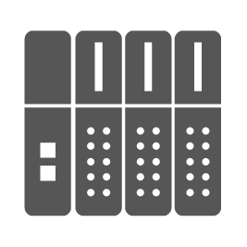
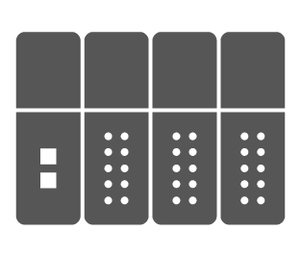
Starting point: PROFINET network today with CC-B
IEEE802 w/o 60802
PROFINET CC-B

Slide 13
Brownfield: Plant with CC-B and spare parts CC-B/D (RT mode)
IEEE802
PROFINET CC-B
PROFINET CC-B/D
If new devices are CC-B/D compliant, they can be replaced in existing systems in a manner compatible with the replacement parts
TSN features are not used in existing systems

Slide 14
Migration: Setting up systems with PROFINET via TSN Interaction of CC-D (TSN) and CC-B field devices
IEEE802
TSN domain
PROFINET CC-B
PROFINET CC-B/D
PROFINET CC-D
To be able to establish a TSN stream between two devices, all devices involved must be TSN compliant.
Devices without TSN prevent the possibility to establish TSN streams.

Slide 15
Greenfield: Set up new systems with TSN Operation with 60802 compliant devices
IEEE802 w/o 60802
PROFINET CC-B
PROFINET CC-B/D (60802 compliant)
PROFINET CC-D
(60802 compliant)
60802 compliant
If all PROFINET devices in the network are CC-D compliant and the network infrastructure is also 60802 compliant, a pure CC-D controller can also be used.

Slide 16
Network Configuration Model
The PROFINET Controller integrates a Network Management Engine
The Network Management Engine provides topology detection, path planning and network configuration
PROFINET provides Plug & Play networks even in motion control applications
The handling of todays engineering tools stays untouched
This approach corresponds to the upcoming TSN-IA Profile (IEC/IEEE 60802)
PROFINET Controller
PROFINET Application Relation
Network Management
Engine (IEC/IEEE 60802)
Network Configuration
CIM
Eth
PROFINET Device (Bridge)
PROFINET Device (Bridge)
PROFINET Device (Bridge)
CIM
CIM
CIM
Eth
Eth
Eth
CIM: Communication Interface Management

Slide 17
Interaction TSN standard, PROFINET, certification
Product certification
Other protocol
Other profiles
Aerospace
AVB
Automotive
TSN-IA Profile IEC/IEEEE 60802
TSN-IA Profile Test IEC 61802
IEEE 802.1-2020 TSN Standard
PROFINET is already prepared for the new TSN-IA profile

Slide 18
I’m in, sign me up for TSN!
TSN is a ‘future orientated’ technology

Slide 19
How standard Ethernet becomes real-time capable…
# | IEEE/IEC/IETF | Description | Details | Status
1 | 61158-x-10 | PROFINET V2.4 | Integration of TSN into PROFINET | Released
2 | 60802 | Industrial Automation Profile | Selection of tools out of TSN toolbox for industrial automation | In work
 | IEEE standards
3 | 802.1AB-2016 | Link layer neighborhood | Neighborhood detection | Released
4 | 802.1AS-2020 | Time synchronization | Multiple synchronization domains | Released
5 | 802.1Q-2018 | Streams | Robust routing of streams within the network | Released
6 | 802.1Q-2018 | Scheduled Traffic | Scheduling of different traffic classes | Released
7 | 802.1Q-2018 802.3-2018 | Frame Preemption | RT streams interrupt TCP/IP streams | Released
8 | 802.1Qdj | Configuration Enhancements | Resolve missing definitions in 802.1Q and 802.1Qcc for network and stream configuration | In work
9 | 802.1CB-2017 | Seamless Redundancy | Stream identification and translation | Released
 | IETF standards
10 | IETF RFCs | Netconf | Selection of protocols for configuration of a Ethernet interface and/or bridge | Released
11 | IETF RFCs | YANG models | Selection of data models for configuration of a Ethernet interface and/or bridge | Released
12 | IETF RFCs | Security | Selection of protocols and data models for configuration of Security | Released

Slide 20
Roadmap: Time from specification to usage
OEMUse
Machine-/
Plant
Update / New
Production
ControllerDevices
Various Manufacturer
System– Integration A
Scheduled by manufacturers
Device – Integration B
Device – Integration C
Device – Integration ..
Various Tech Provider
Dev-Kit / HW/ FW-Stack X
Scheduled by supplier
“ecosystem”
Dev-Kit / HW/ FW-Stack
Continuous Enhancements/Maintenance
Dev-Kit / HW/ FW-Stack Y
Dev-Kit ...
PI
04/2020
Certification
V2.4
V2.41 / IECEE
06/2019
“Some time from the Spec to the Usage”
PROFINET-Spec
V2.4
V2.4 MU1
V2.4 MU2, ….
IEEE
TSN
IEEE 802.1-2018
2018
IEEE / IEC 60802

Slide 21
Summary of benefits
Robustness
Plug and work
Higher bandwidth
IEC/IEEE world wide open standard
M2M real time cross manufacturer communication (inc. safety)
Clear modernization path, confidence todays investment is protected
PROFINET is well prepared to provide or integrate into secured converged networks based on TSN Industrial Automation profile
Business as usual, nothing has changed at the application layer. Projects can be re-used

Slide 22
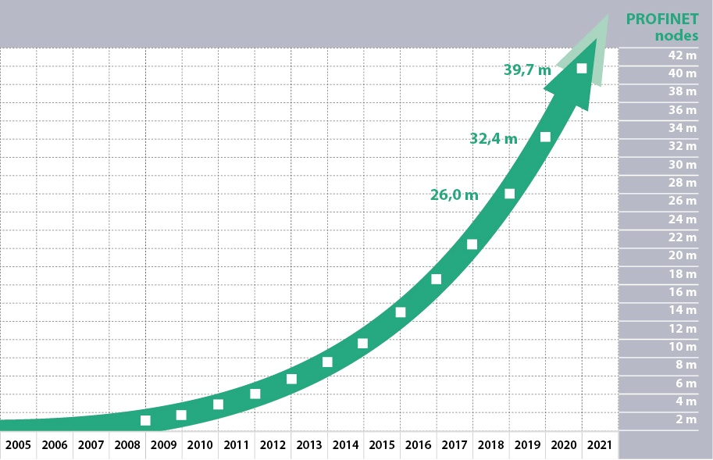
Unlock the potential with PROFINET devices available today
There are 40 million PROFINET nodes worldwide today.
These can benefit from a TSN network

Slide 24
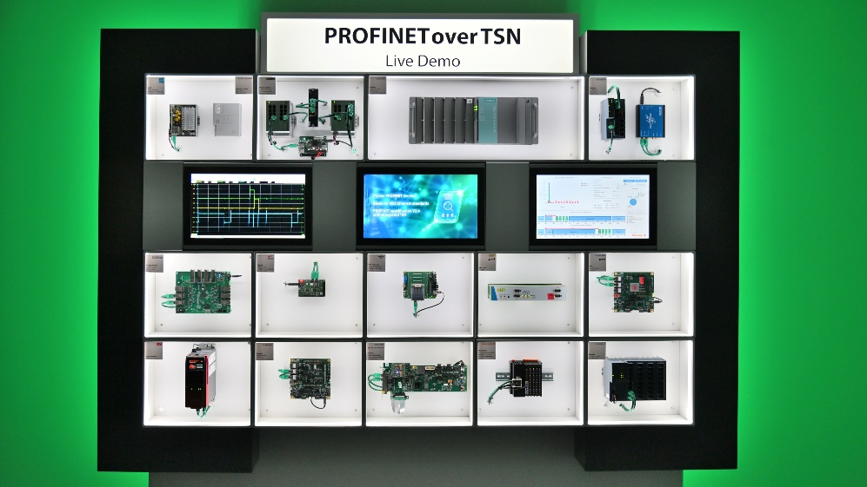
Some ‘light’ reading!
IEC/IEEE 60802 TSN Profile for Industrial Automation
Video of PROFINET over TSN live demo
PROFINET over TSN is the foundation for Industry 4.0

Slide 25
Thank you!
Any questions?

