Slide 1
The Road to Net Zero &
Importance of Data Collection
Mark Jones
Senior Energy Engineer
ENERGY MANAGEMENT & CONSULTING

Slide 2
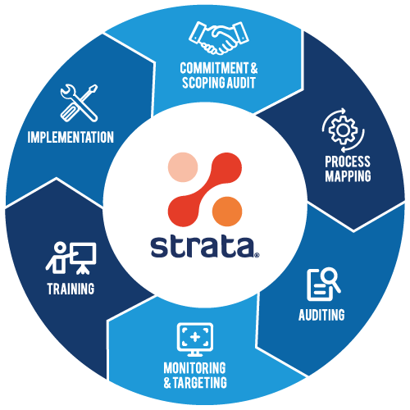
Cotopaxi Overview
Operating since 2009
Clients across 70+ countries
Chartered Energy Consultants, Engineers & IT Specialists
Utility and sustainability solutions provider
Strata - In-house developed Process and optimization software
Over 2,500+ projects completed
Part of Spirax Sarco Engineering

Slide 3
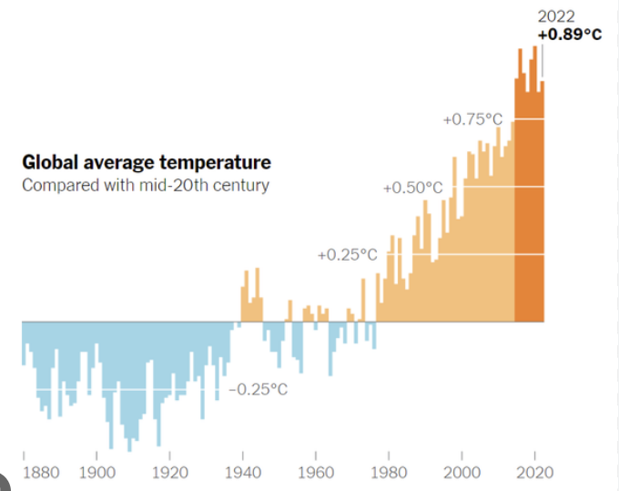
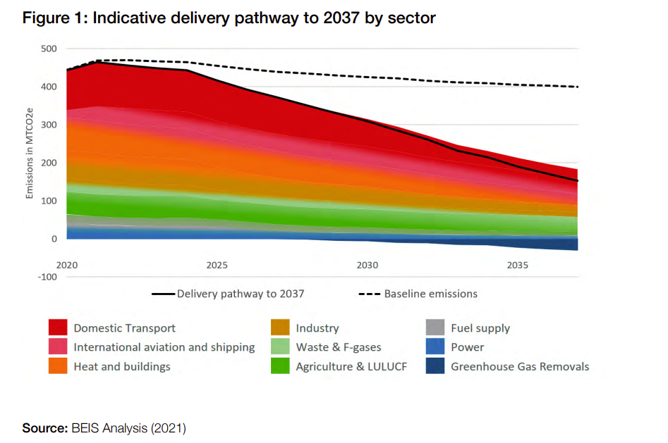
Climate Change – What is it?
Climate Change
Long term shifts in temperatures and weather patterns
Can be both natural and human driven.
Target to not exceed 1.5ºC increase in average temperature
Current models point to a 2.5 – 4ºC increase by end of the century
Effects weather, health, food supply, housing
Regulatory Strategy
Paris Agreement to limit global temperature increase to 2ºC
Net-zero target in UK by 2050
Deployment of more renewable energy sources
Phase out traditional petrol & diesel cars
Further regulations coming to businesses

Slide 4
Net Zero – What, Why & How?
What?
According to the Science Based Target Initiative (SBTi) – “Net Zero emissions are achieved when anthropogenic emissions of greenhouse gases to the atmosphere are balanced by anthropogenic removals over a specified period”
Why?
Reduce Our Impact on the Planet
Significant resource cost savings (Energy/Water/Waste)
Environmental compliance – tougher regulations coming
Enhanced brand value
Reduced business risk
Improved capex deployment
How?
Stage 1 – Measure, Monitor & Target
Stage 2 – Optimise Existing Systems
Stage 3 – Implement Zero Carbon Energy Systems

Slide 5
Journey to Net Zero
Measure, Monitor
& Target
Optimise Existing
Systems
Implement
Zero Carbon
Energy Systems
Stage 1
Stage 2
Stage 3
Implement Utility &
Process Monitoring
Complete Regular Utility Audits
Implement Energy Reduction Projects
Review BAT
Complete Feasibility Studies
Green Project Installation
Design & Implement Utility Digitalisation Strategy
Correct Selection of Metering and DCS – accurate data
Establish clear utility consumption and emissions baseline
Understand Energy/Water Efficiency Baselines
Implement Regular Governance
Use Data to Create Initial Net Zero Roadmap
Complete Regular Internal & External Audits.
Regular Data Review & Analysis
Implement Best Practice Across all Utilities
Maximise Energy Recovery & Water Conservation
Energy/Water Efficiency Projects – Standard Technical Solutions
Understand Current & Future Business Requirements
Review Best Available Technologies (BAT)
Complete technical feasibility studies on multiple technologies
Understand pros and cons of each Green Energy Technology
Implement Green Energy Systems
Continuous Monitoring to Optimise

Slide 6
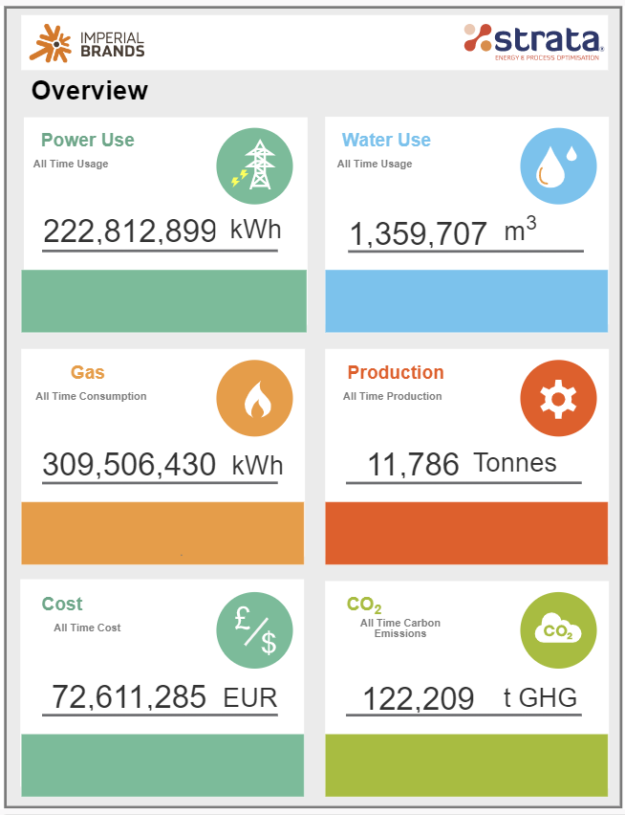
Stage 1 – Measure, Monitor & Target
Complete full assessment of existing utility systems and processes
Complete utility line diagrams and metering gap analysis
Implement smart metering and data collection system
Correct sizing and meter type is crucial for accuracy later in the process
Create utility benchmarks and KPIs
Implement governance to analyse performance and drive improvement.
YOU CAN'T MANAGE WHAT YOU DON’T MEASURE

Slide 7
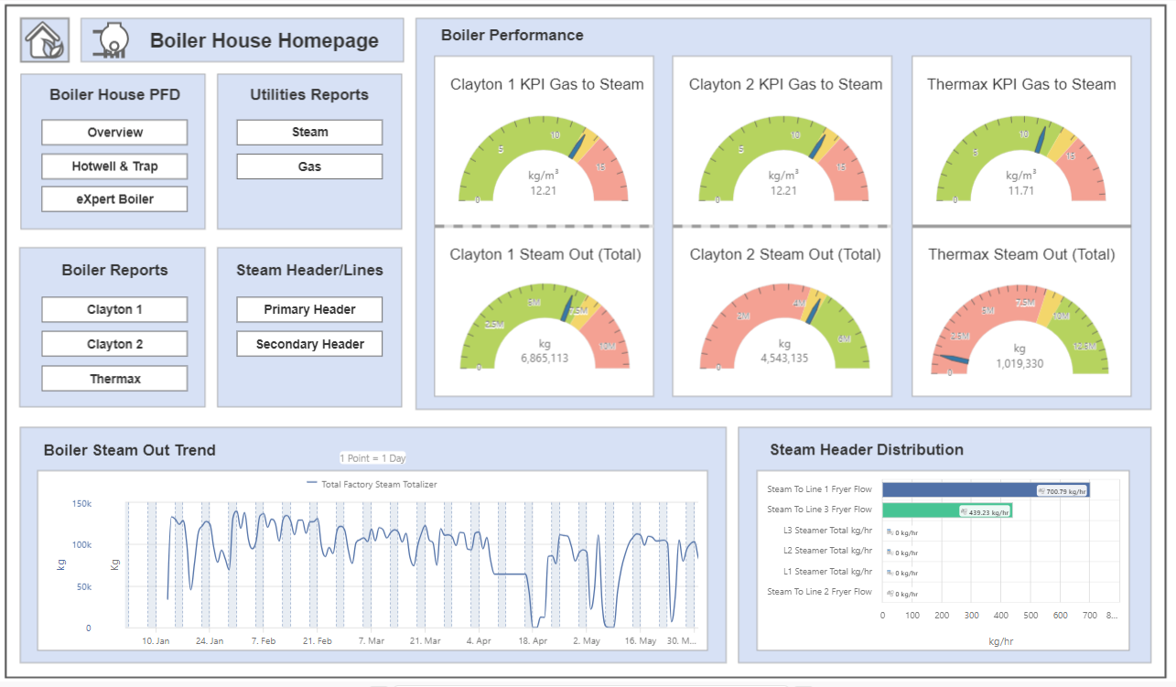
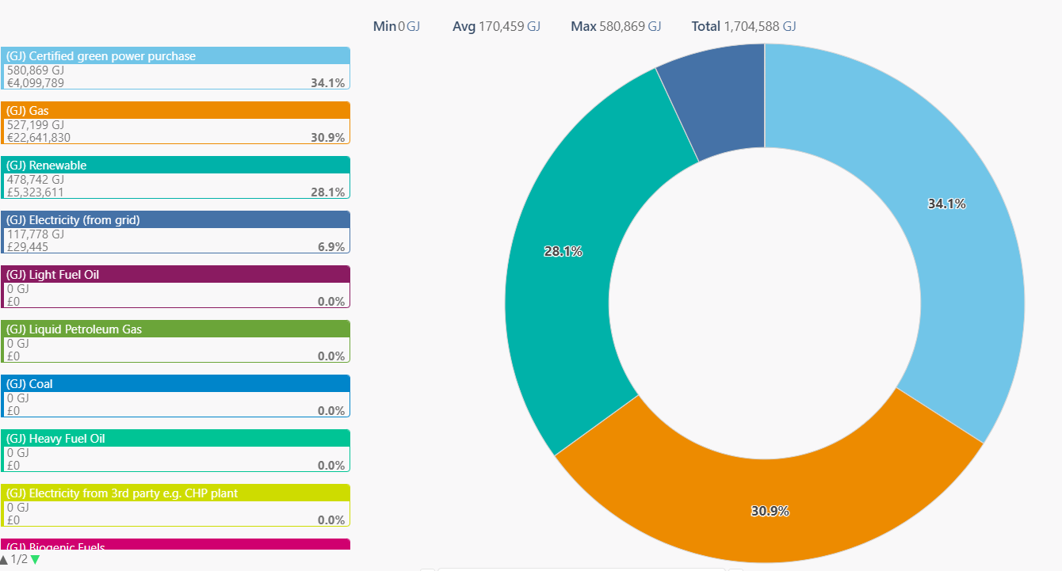
Stage 1 – Measure, Monitor & Target – Energy Data Management
KPI Tracking & Performance Reviews
Understand Current Energy Mix and Load Curve

Slide 8
Stage 1 – Data Driven Improvement
Improved understanding of control processes for machinery
Improved understanding of load profiles & baselines
Validate improvements – financial savings, reduced emissions

Slide 9
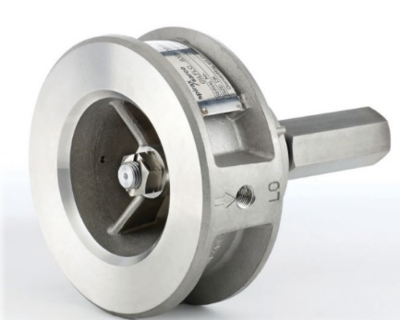
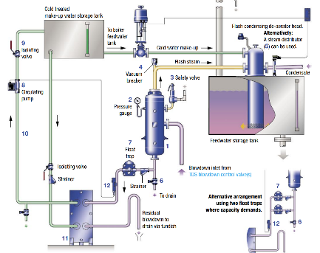
Stage 2 – Optimise Existing Systems
Low / No Cost Solutions
Standard Investment Solutions
Improved Control
aM&T Insights
Energy Awareness
Trap Management
ISO 50001
Systems Optimisation
Waste Minimisation
Energy / Water Audits
Peak load shedding
Baseload Reduction
Motor Management
Frequency Drives
Control Systems
Pinch / Heat Integration
Heat Recovery
Free Cooling
Insulation
Reuse/Recycle
LED Lighting

Slide 10
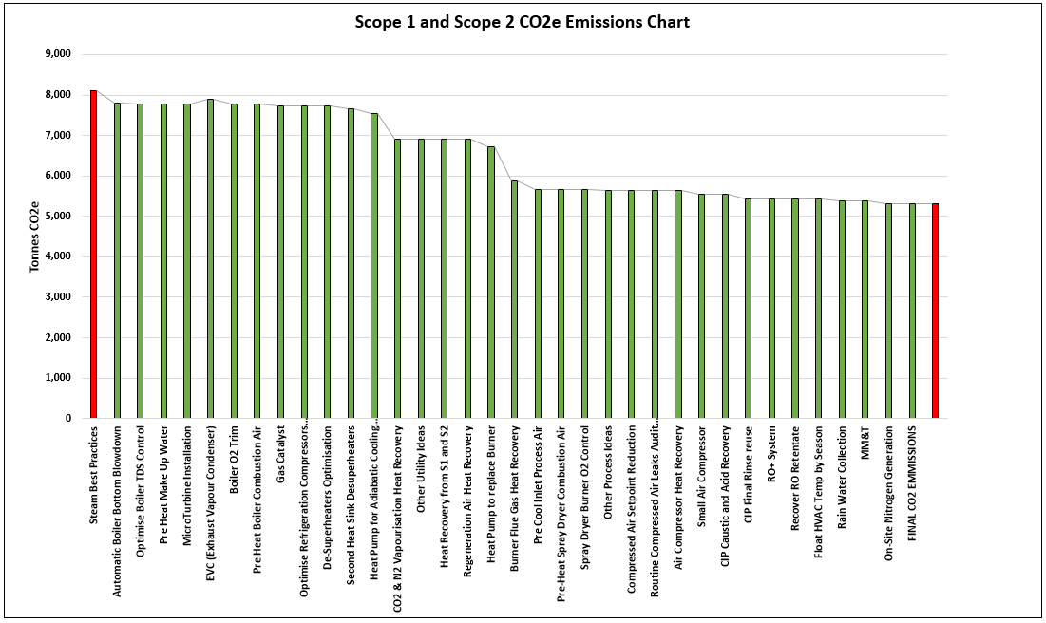
Stage 2 – Optimise Existing System
Target any “low hanging fruit”
Leaks, baseload etc.
Optimise existing processes
Heat Recovery
Best Practice Control
Mitigate Losses
Correctly size more efficient processes & equipment

Slide 11
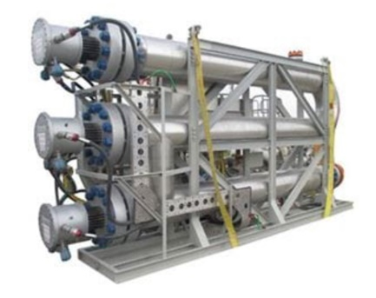
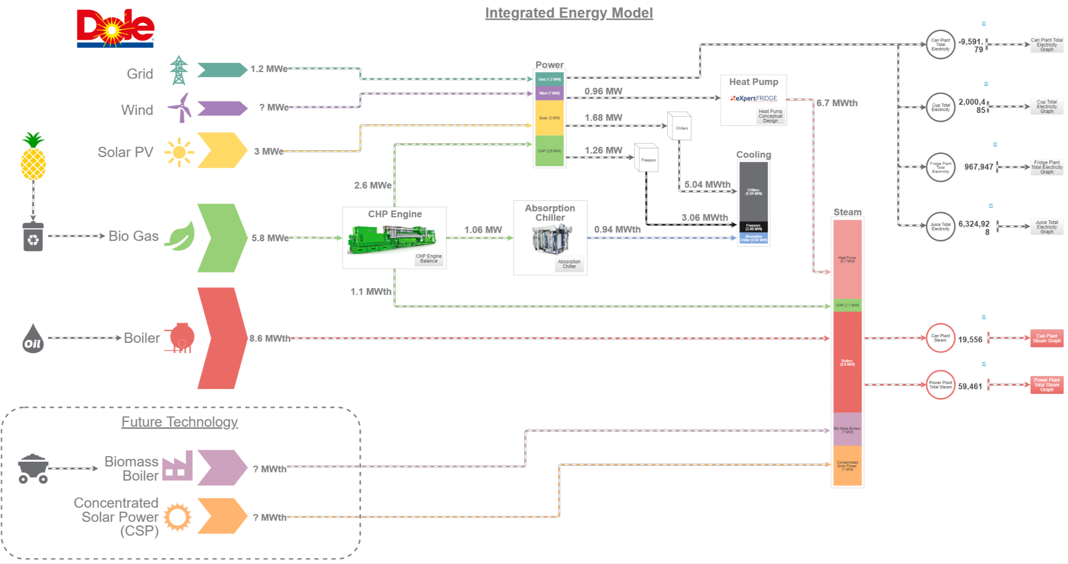
Stage 3 – Implement low / Zero Carbon Energy Systems
Low / Zero Carbon Technologies
Create Integrated Energy Model that can simulate various technologies,
different fuel mixtures, future energy prices and resource availability.
Integrated Energy Model
Electric Boiler
Solar PV / Thermal
Wind Turbines
Absorption Chillers
Anaerobic Digestion
Biomass Thermal / Power
District Heat Network
Electric Vehicles (EV)
Heat Pumps

Slide 12
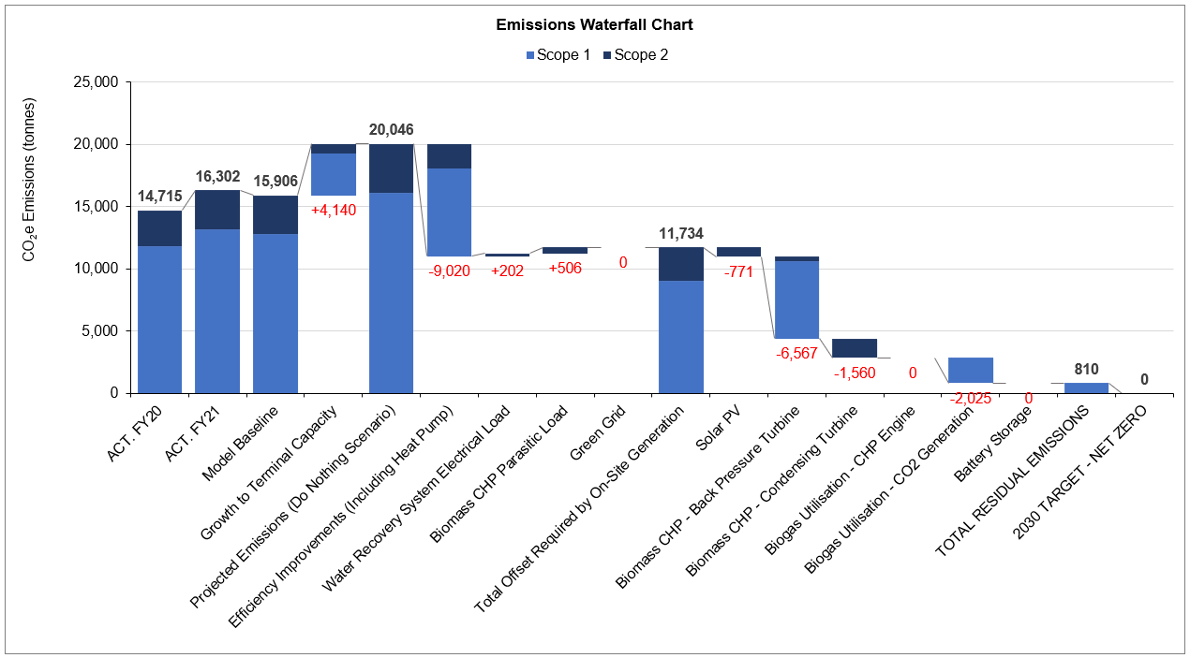
Stage 3 – Emissions Waterfall Chart
Investigate Different Technologies
Correct Sizing of Equipment
Utilise Optimal Technology Mix
Understand Energy Load Profile

Slide 13
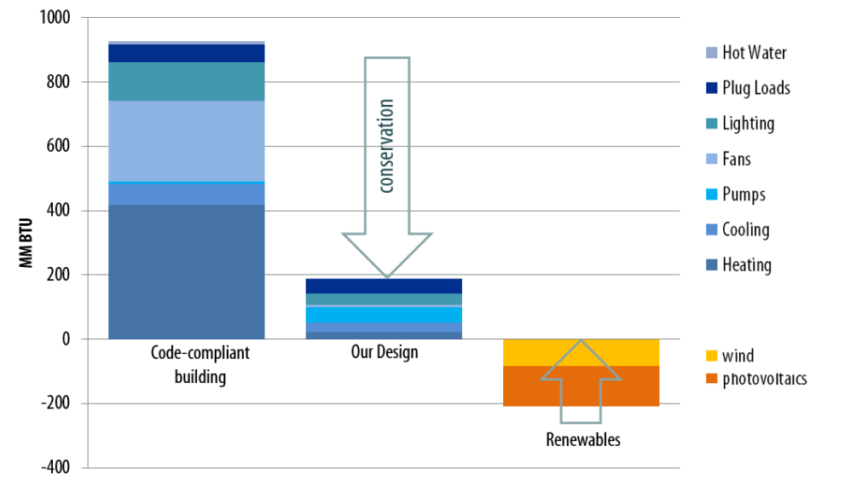
Process Result
Improved equipment design
Maximised Energy & Water Recovery
Reduced Overall Energy Load
Correct Sizing of Renewables
Reduced overall CAPEX Cost
Long term improved payback
Optimisation
kW
kW
Current Process
Optimised Process
kW
kW
Renewables
kW

Slide 14
Journey to Net Zero - Recap
Measure, Monitor
& Target
Optimise Existing
Systems
Implement
Zero Carbon
Energy Systems
Stage 1
Stage 2
Stage 3
Implement Utility &
Process Monitoring
Complete Regular Utility Audits
Implement Energy Reduction Projects
Review BAT
Complete Feasibility Studies
Green Project Installation
Design & Implement Utility Digitalisation Strategy
Correct Selection of Metering and DCS – accurate data
Establish clear utility consumption and emissions baseline
Understand Energy/Water Efficiency Baselines
Implement Regular Governance
Use Data to Create Initial Net Zero Roadmap
Complete Regular Internal & External Audits.
Regular Data Review & Analysis
Implement Best Practice Across all Utilities
Maximise Energy Recovery & Water Conservation
Energy/Water Efficiency Projects – Standard Technical Solutions
Understand Current & Future Business Requirements
Review Best Available Technologies (BAT)
Complete technical feasibility studies on multiple technologies
Understand pros and cons of each Green Energy Technology
Implement Green Energy Systems
Continuous Monitoring to Optimise

Slide 15
Thank You!
Mark Jones
Senior Energy Engineer
ENERGY MANAGEMENT & CONSULTING

