Slide 1
OPC UA & OPC UA Security
What is it? Why use it? See it in use
Dave Tomlin & Pavel Sitcha – AFRC Glasgow 2023

Slide 2
Agenda
1
What Is OPC UA?
2
Who Is involvoved?
3
What can we do with OPC UA?
4
How does it work with PROFINET?
5
Benifits to you
6
OPC UA Security
7
Demonstration

Slide 3
What is OPC & OPC UA?
OPC (Open Platform Communications) is:
OPC UA (Unified Architecture) is:
Built on the success of OPC DA & A&E
Functionally Equivalent
Platform independent (no need for Windows)
Secure
Extensible
Eliminates the need for DCOM
A standard method of interacting
It is platform independent
The OPC Foundation is responsible for the development and maintenance of this standard.
The OPC standard is a series of specifications developed by industry vendors, end-users and software developers.
Also known as OPC DA & OPC A&E
Notes:
is the interoperability standard for the secure and reliable exchange of data in the industrial automation space and in other industries. It is platform independent and ensures the seamless flow of information among devices from multiple vendors. The OPC Foundation is responsible for the development and maintenance of this standard.
These specifications define the interface between Clients and Servers, as well as Servers and Servers, including access to real-time data, monitoring of alarms and events, access to historical data and other applications.

Slide 4
Who is involved?
OPC Foundation Members (>450 members)
GE
ABB
ProSoft Technology
SAP
Softing Industrial Automation
ascolab
Phoenix Contact
Bosch
Siemens
CERN
Emerson Process Management
Bosch Rexroth
Cisco Systems
Yokogawa Electric Corporation
Endress+Hauser
BSI
Beckhoff Automation
Schneider Electric
Fraunhofer IOSB
Pilz
B&R
IBM
HMS Industrial Networks
Festo
Honeywell
Unified Automation
Microsoft
FANUC
Hilscher
Rockwell Automation

Slide 5
Which systems interact with OPC?

Slide 6
What can we do with it? OPC UA - Range of functions
Browsing
Read / Write
Registered Read / Write
Subscription
Methods
Companion Specification
Alarms & Conditions
Client
Client
Client
Client
Client
Client
Client
Browse Request
R/W Request
Reg. Nodes Request
R/W Request
Publishing
Call Request
Browse Response
R/W Response
R/W Response
Call Response
Reg. Nodes Response
Sampling
Server
Server
Server
Server
Server
Server
Server
Browsing of CPU data
Asynchronous data access
High performance during repeated access
Load reduction during HMI / Monitoring applications
Consistent transmission w/o manual handshake
Information modeling
Alarms and events with acknowledge-ment

Slide 7
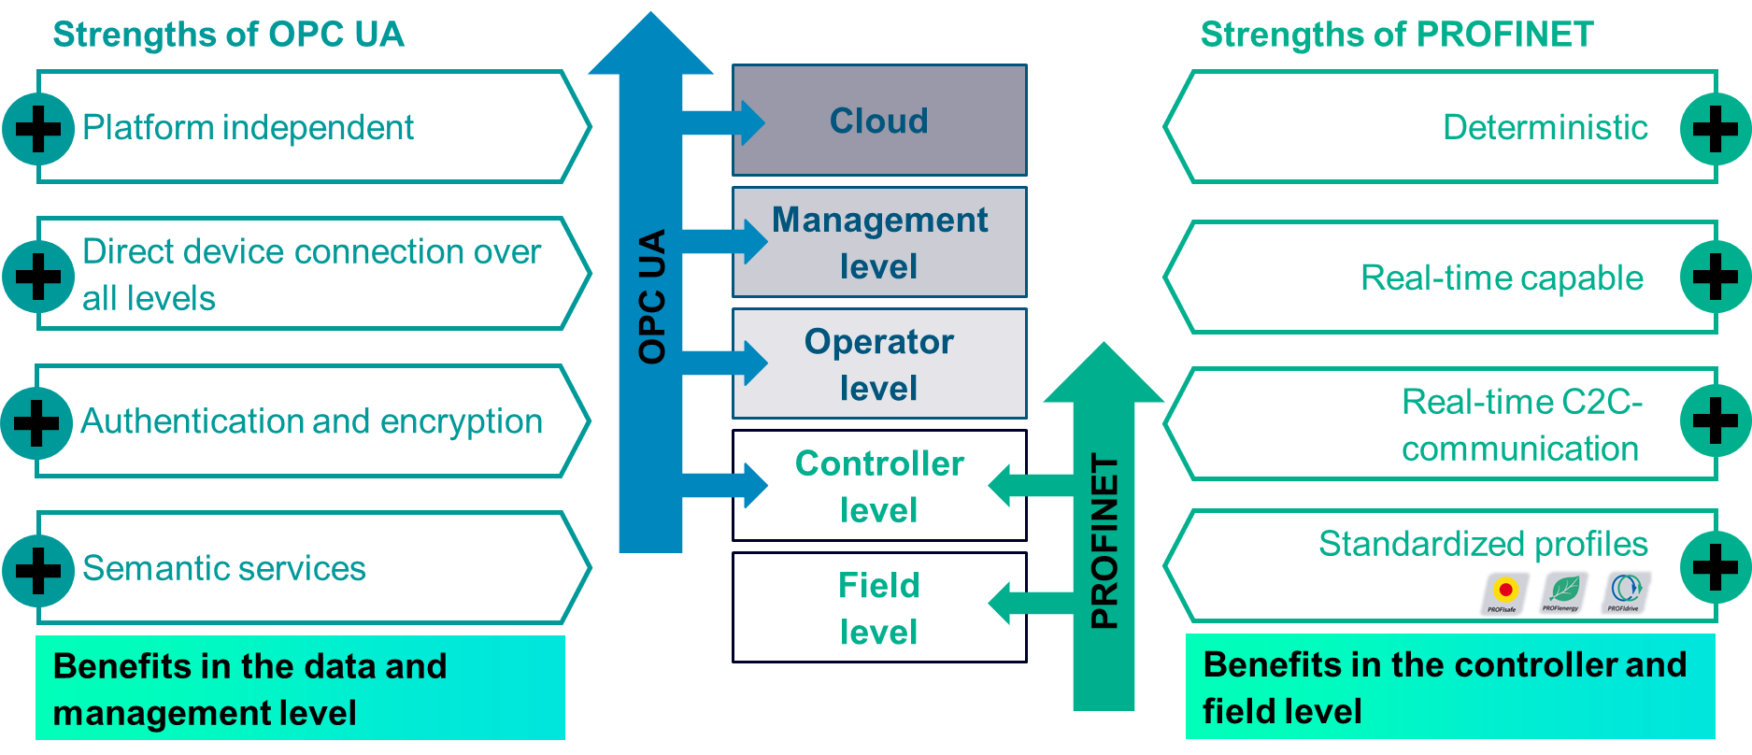
OPC UA and Profinet Working Together

Slide 8
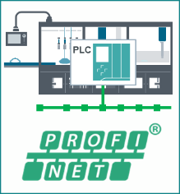
OPC UA and Profinet in Automation
Cloud
MES, ERP
Manufacturing Execution System
SCADA, DCS
OPC UA
SCADA- System
Energy management
Industrial Ethernet
Engineering- Framework
Controller
HMI
IPC
Industrial Communication
Motion
Control
CNC
PROFINET
Power supply and distribution
Industrial Identification
Decentral IO
Drives
Industrial controllers

Slide 9
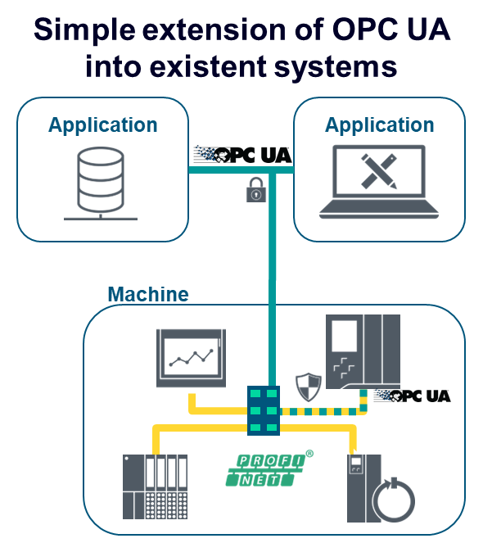
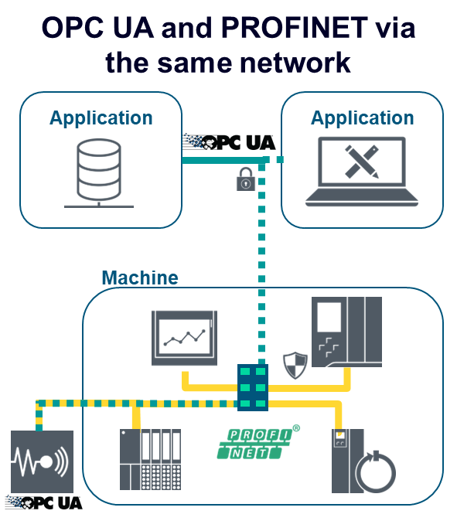
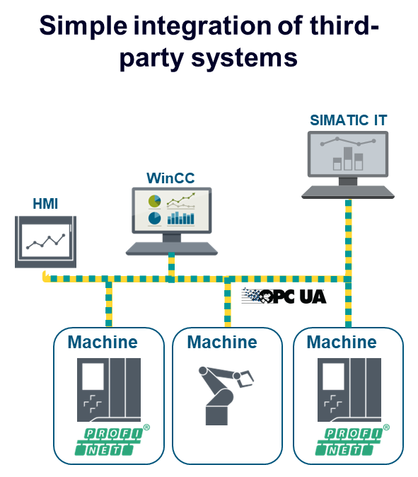
OPC UA and Profinet in the same Network
PROFINET OPC UA OPC UA + PROFINET
Vertical communication and simple line integration
Notes:
It can be added incrementally to existing networks with very little change to existing infrastructure

Slide 10
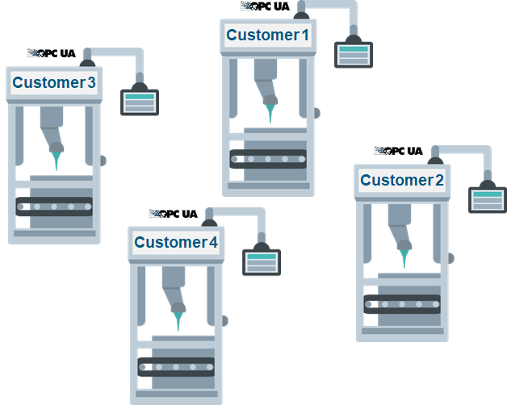
Engineering and User Benefits
Benefits for machine manufacturers
Benefits for line integrators
Benefits for machine operators
Less engineering effort due to reusable interfaces for multiple customers
Straightforward line integration due to standardized interfaces on every machine
On-demand connectivity and access to machine parameters and process values

Slide 11
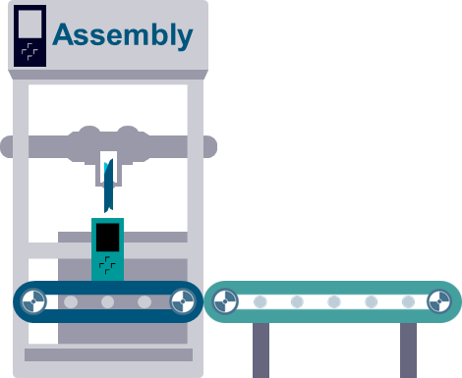
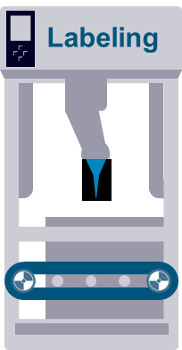
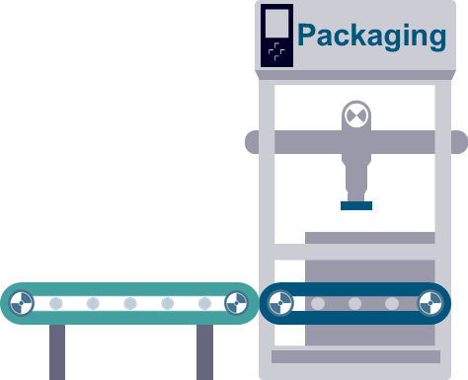
OPC UA and Profinet Manufacturing concept
Cloud Gateway
Edge
device
Client
Client
Manufacturing
Management
Monitor unit count
Calculate OEE
HMI
Monitor process
Client
Control machine
Server
Get production data
Report quality data
Workpiece handover
Workpiece handover
Client / Server

Slide 12
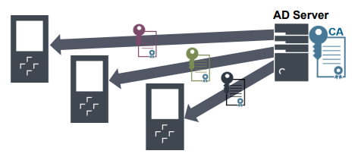
How to keep it Secure
OPC UA security actions are based on the following IT standards:
Encryption
Signing
Authentication via certificate and user accounts
For setup we may need to speak to our friends in the IT department
Notes:
These were not available for OPC Classic
Note: Security mechanisms have a negative effect on performance, especially when establishing a connection. While operating, performance is reduced by approx. 10%.

Slide 13
Over to Pavel for a demonstration...

Slide 14
Any questions?
Dave Tomlin – dtomlin@hitex.co.uk Pavel Sitcha - pavel.sticha@softing.com

